Slide 1
SATHYA VELA KUMAR R
Final Project
3/21/2024 Annual Review

Slide 2
PROJECT TITLE
FACE EMOTION RECOGNITION USING CNN
3/21/2024 Annual Review

Slide 3


AGENDA
Problem Statement
Problem Overview
Who are the END USERS ?
Your Solution and its Value Preposition
The WOW in your solution
Modelling
Results
3/21/2024 Annual Review

Slide 4

PROBLEM STATEMENT
Facial emotion recognition is an AI technology that uses machine learning algorithms to analyze a person's facial expressions and interpret their emotions. It can be applied in various fields such as psychology, marketing, and security. Various Facial Emotion Recognition (FER) projects employ diverse programming languages and deep learning methods to analyze emotions in images and videos.
This article delves into a Python-based Facial Expression Recognition project, focusing on training a deep neural network to discern emotions from facial images. The challenge lies in accurately predicting emotions from grayscale facial images, categorizing expressions into seven basic emotions: happiness, sadness, surprise, fear, anger, disgust, and neutrality. The ultimate aim is to develop a real-time capable machine learning model for accurate facial emotion recognition.
3/21/2024 Annual Review

Slide 5

PROJECT OVERVIEW
Facial emotion recognition is an AI technology that uses machine learning algorithms to analyze a person's facial expressions and interpret their emotions
Various Facial Emotion Recognition (FER) projects employ diverse programming languages and deep learning methods to analyze emotions in images and videos.
This article delves into a Python-based Facial Expression Recognition project, focusing on training a deep neural network to discern emotions from facial images.
The sample data is taken from the datasheet and preprocessed.
Once the data is preprocessed, using Haar-cascade frontal face algorithm , the data is trained to recognize the face.
The CNN algorithm is then applied to detect the different facial emotions.
3/21/2024 Annual Review

Slide 6

WHO ARE THE END USERS?
Facial emotion recognition is an AI technology that uses machine learning algorithms to analyze a person's facial expressions and interpret their emotions. It can be applied in various fields such as
Psychology: FER has contributed to the understanding of human emotions and behavior, and it has helped researchers to develop new theories and models of human emotional states and responses .
Sociology: FER has contributed to the understanding of social interactions and communication, and it has helped researchers to analyze and interpret nonverbal cues and facial expressions in social contexts.
Marketing: FER has contributed to the understanding of consumer behavior and preferences, and it has helped marketers to design more effective advertising and marketing campaigns .
Security: FER has contributed to the development of new security systems and technologies, and it has helped law enforcement to detect and prevent criminal activities.
3/21/2024 Annual Review

Slide 7

YOUR SOLUTION AND ITS VALUE PROPOSITION
Value Proposition:
Accuracy: High precision in recognizing a wide spectrum of emotions, ensuring reliable results in various applications.
Real-time Processing: Instantaneous analysis of facial expressions, enabling quick response times for enhanced user experiences.
Versatility: Integration capabilities across diverse platforms and industries, catering to a wide range of use cases.
User Experience Enhancement: Personalized interactions based on emotional cues, leading to more engaging and tailored experiences.
Privacy Protection: Compliance with privacy regulations and implementation of robust security measures to safeguard user data.
Scalability: Ability to handle large-scale deployments and increasing data volumes without compromising performance.
3/21/2024 Annual Review

Slide 8

THE WOW IN YOUR SOLUTION
Deep Learning Mastery:
Our solution harnesses the power of state-of-the-art deep learning techniques, ensuring unparalleled accuracy in recognizing subtle facial expressions and emotions.
Real-time Emotion Analysis:
Experience the thrill of instantaneous emotion detection! Our solution processes facial expressions in real-time, delivering lightning-fast insights for seamless user interactions.
Emotion-Driven Personalization:
Unlock the magic of emotion-driven personalization! By understanding users' emotions, our solution tailors experiences and content delivery, creating unforgettable and deeply engaging interactions.
Privacy with Peace of Mind:
Feel secure with our commitment to privacy! We employ cutting-edge privacy protection measures, ensuring user data remains confidential while still providing exceptional emotion recognition capabilities.
Scalability Beyond Limits:
Scale effortlessly with confidence! Our solution is designed to handle large-scale deployments, empowering businesses to meet growing demands without compromising on performance or accuracy
3/21/2024 Annual Review
8

Slide 9
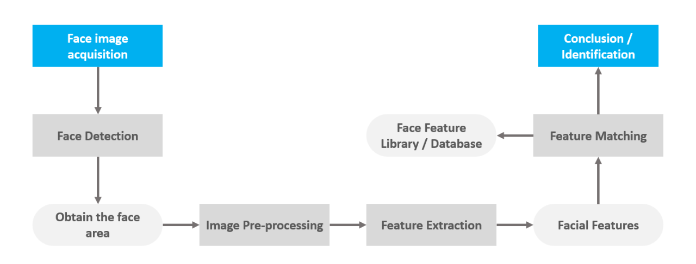
MODELLING
3/21/2024 Annual Review
9

Slide 10
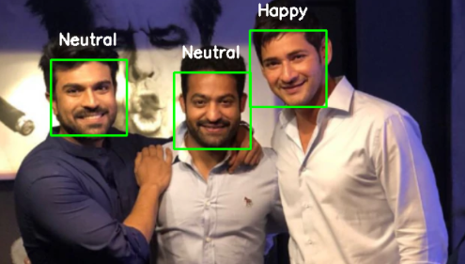
RESULTS
The results of our Face Emotion Recognition Project speak for themselves – delivering tangible benefits and driving success across various industries and use cases.
Demo Link
3/21/2024 Annual Review
10

